Slide 1
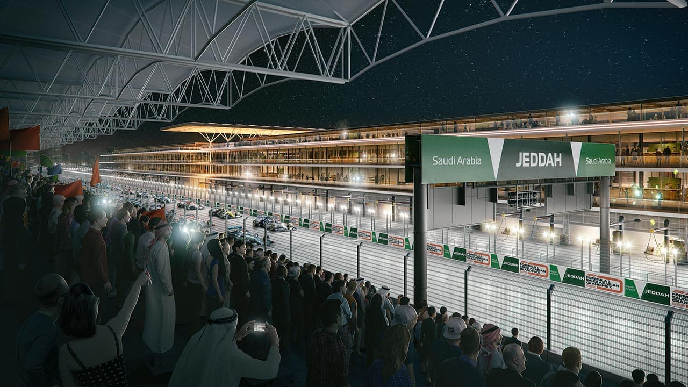
Formula one racing
Formula One (also known as Formula 1 or F1)

Slide 2
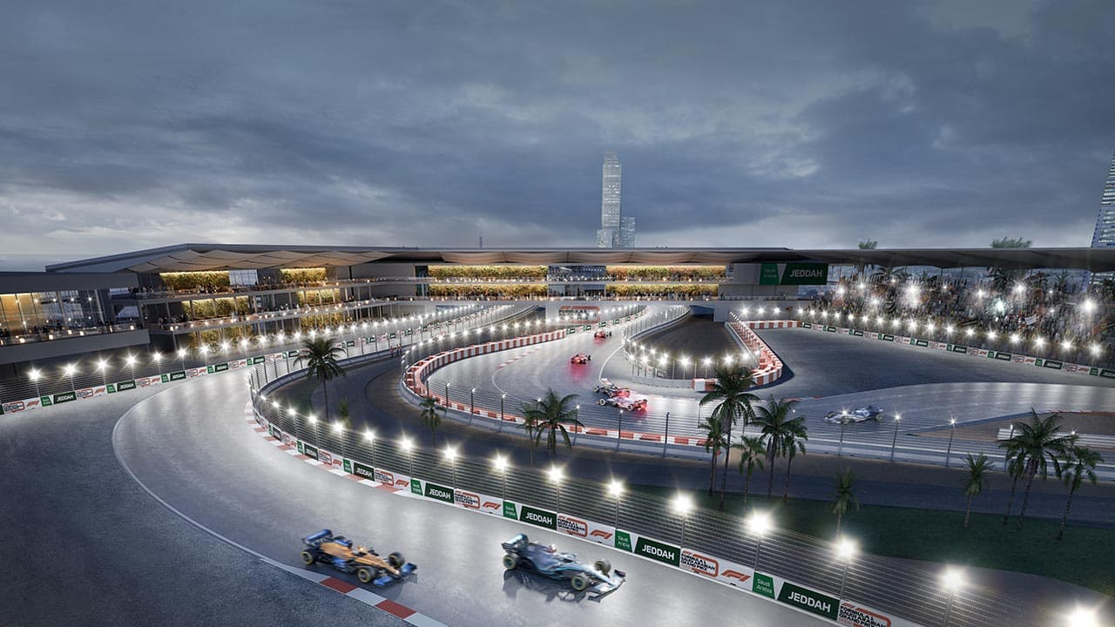
Data Analysis over Formula 1 dataset (1950-2021) Formula 1 is one of most popular and highly enjoyed sport across the globe. Extreme precision, high accuracy and excellent team are the key constituents for a team to participate and win the grand prix. The moment anyone decides to act on their own, the team can either lose position or straight away get out of the competition. All the major teams like Scuderia Ferrari, McLaren, Redbull, Renault and numerous others compete for the world championship. As data science enthusiasts and huge fans of Formula1, we thought of analyzing the Formula1 dataset that we took from Ergast Developer API which provided us with the open dataset that in turn provided us with numerous data attributes like Formula1 drivers, races, lap timings, seasons data, pitstop status and other related attributes.
Tools : There are tools that will be used to achieve the goal of this study, such as: TensorFlow, matplotlib, pandas, nltk for discovering the data and train a model. The work will be done through Jupyter notebook. Furthermore, the Sentiment Analysis from nltk will be used to determine the target of the data in order to train the model in supervised manner.

Slide 3
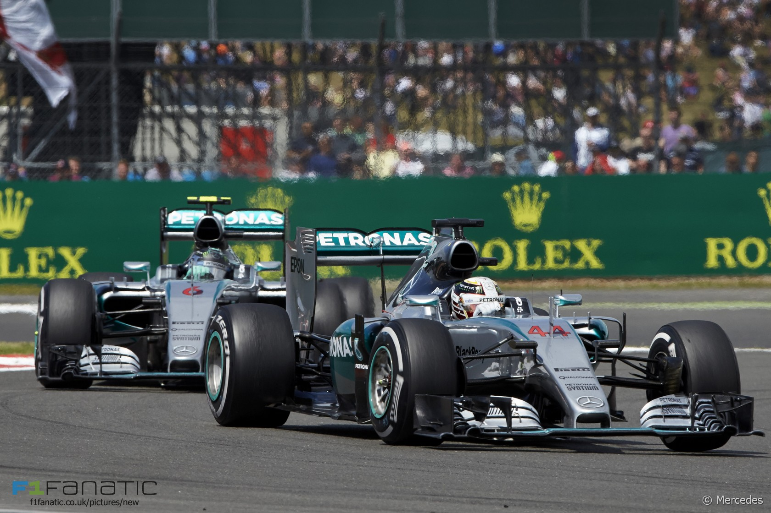
We will focus on :
Who has won on F1and how many races did he run ?

Slide 4
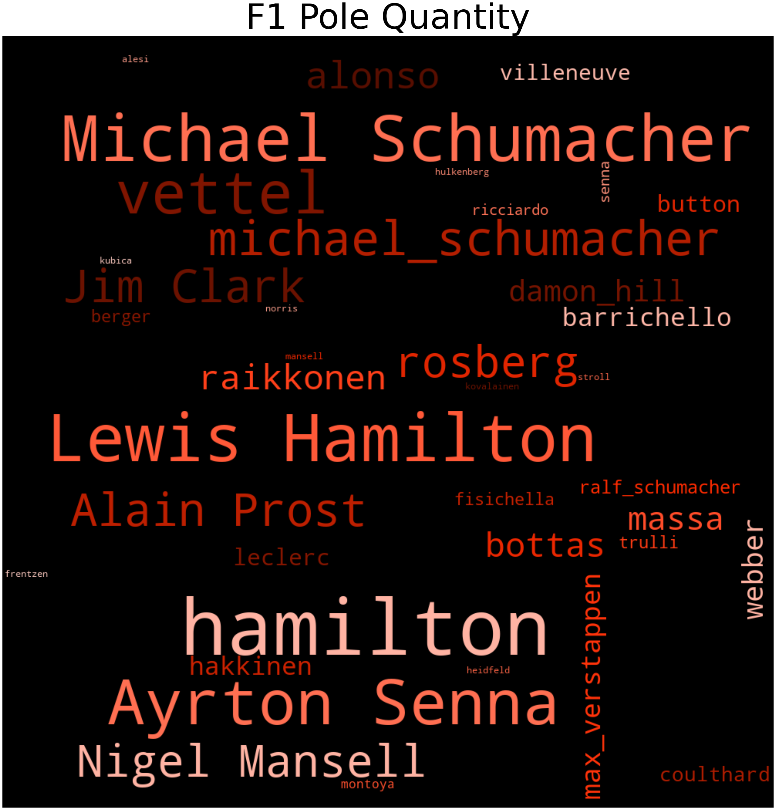
Hamilton is now in his 13th season in F1, with five world championships and 81 race wins. Only Michael Schumacher has more, with seven and 91. Hamilton is in every position to surpass the German’s records that most had thought would be untouchable. Since his debut for McLaren in 2007 at 22 when he immediately took the fight to his double world championship-winning teammate, Fernando Alonso, it was clear he would go far.(Obs: The DataSet presented is not updated since 2021)

Slide 5
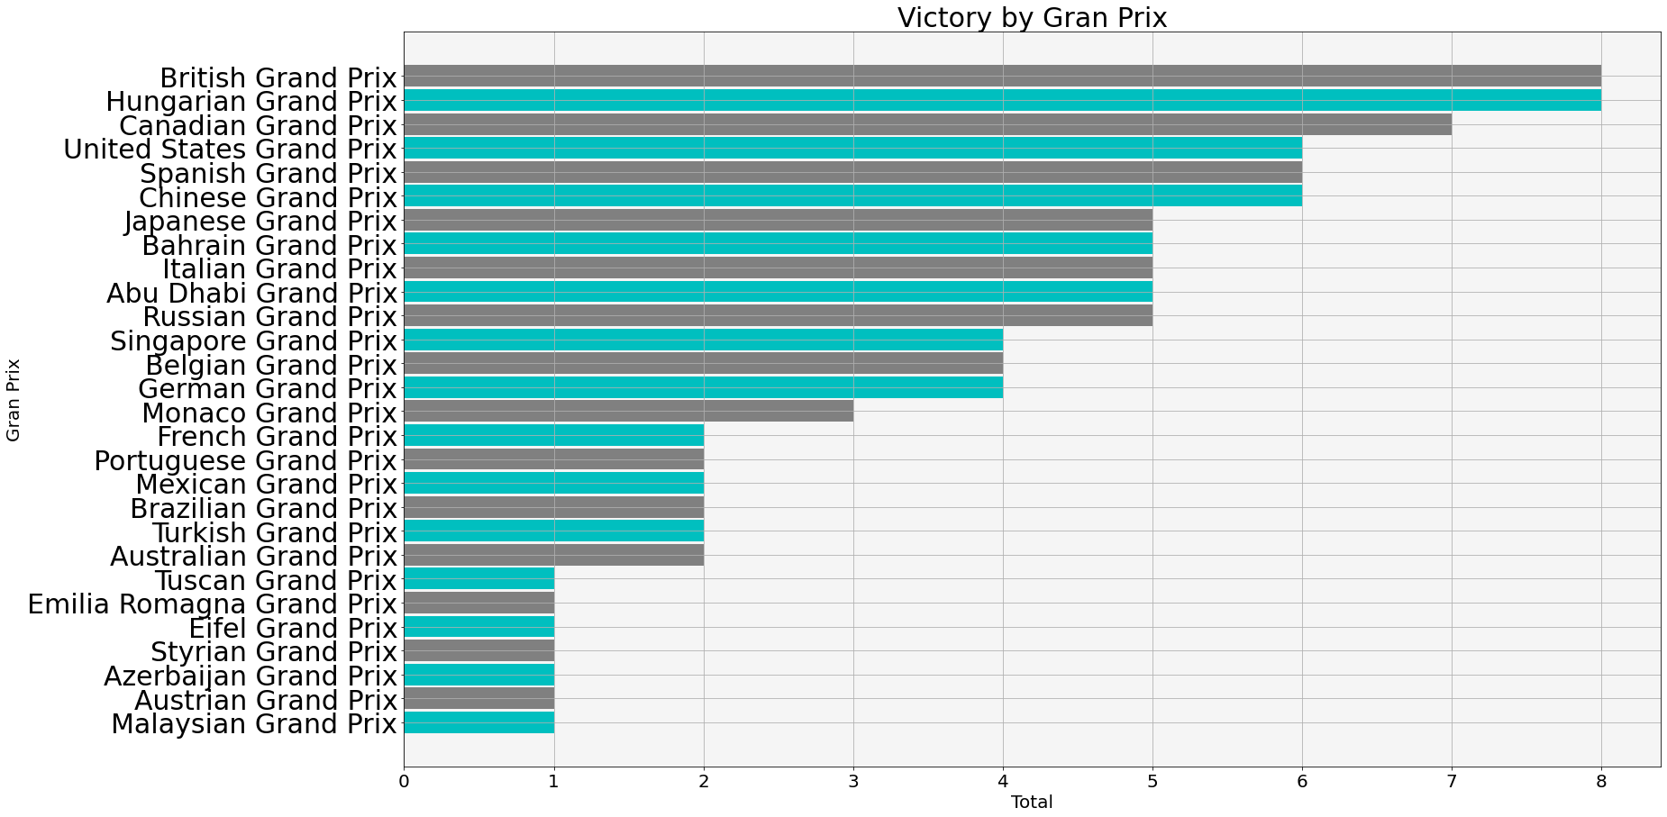
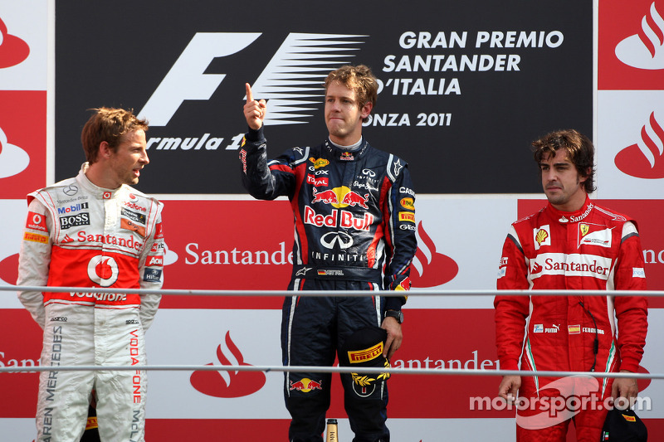
As you can see in the graph below, his favorites are the US and Canadian GPs, where he accumulates the most wins

Slide 6
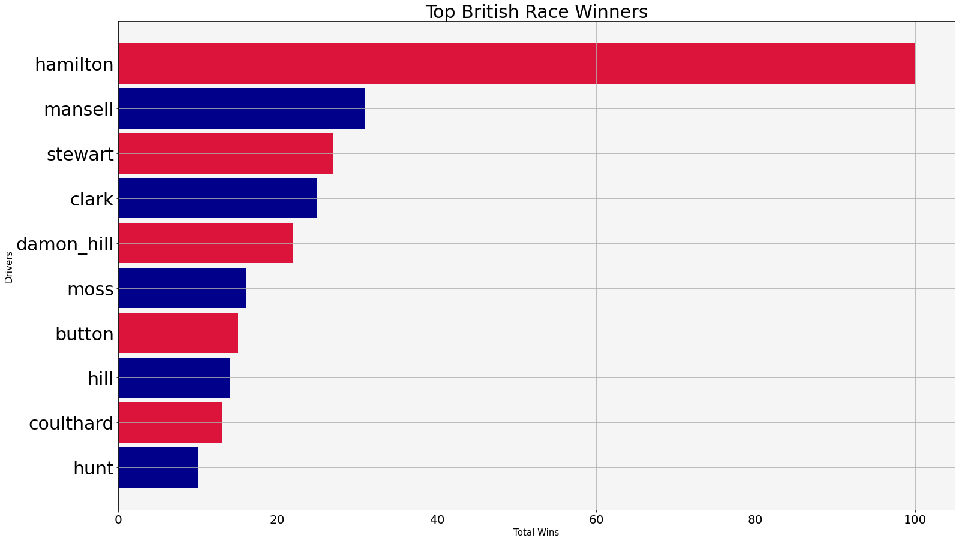
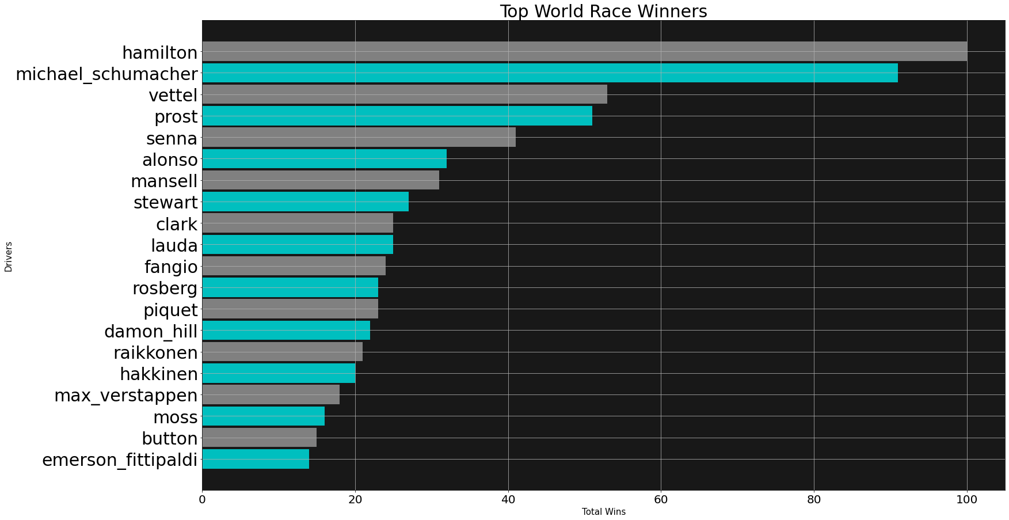
The fact that Lewis is one of the best F1 racers we already know, but let's compare with other idols in the category.

Slide 7
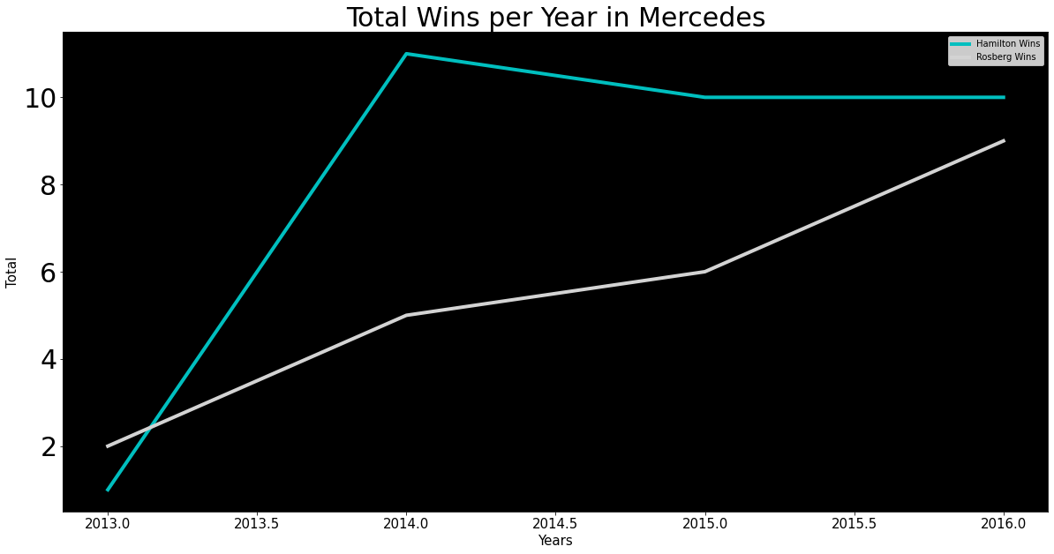
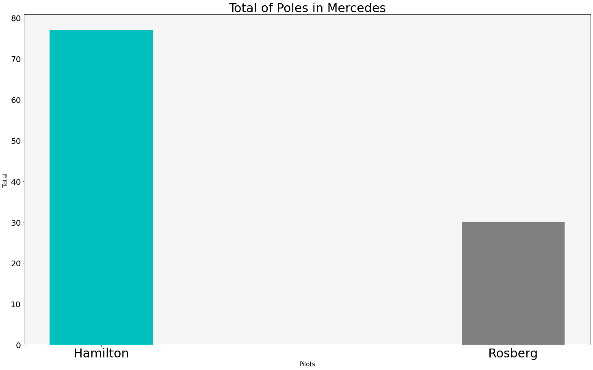
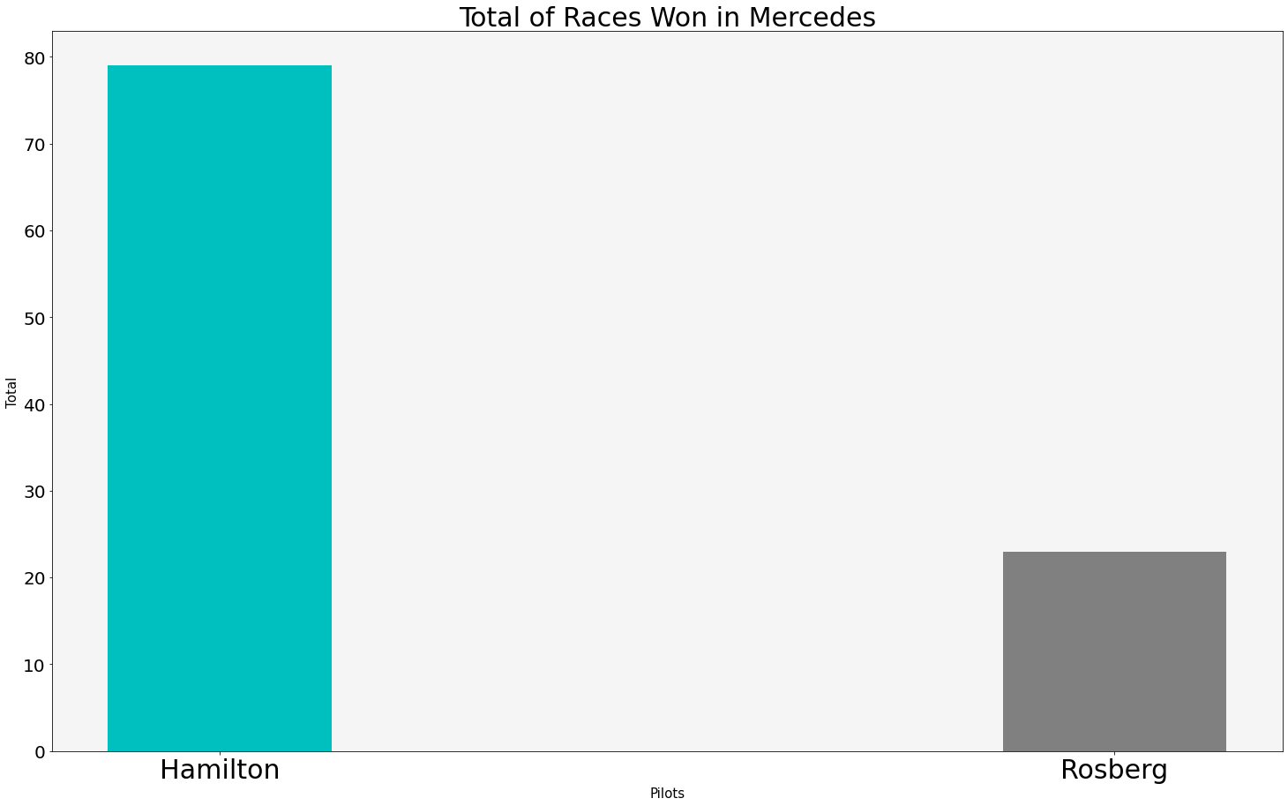
Let's dive into the competition between one of the drivers who challenged Ham was Rosberg winning the 2016 championship

Slide 8
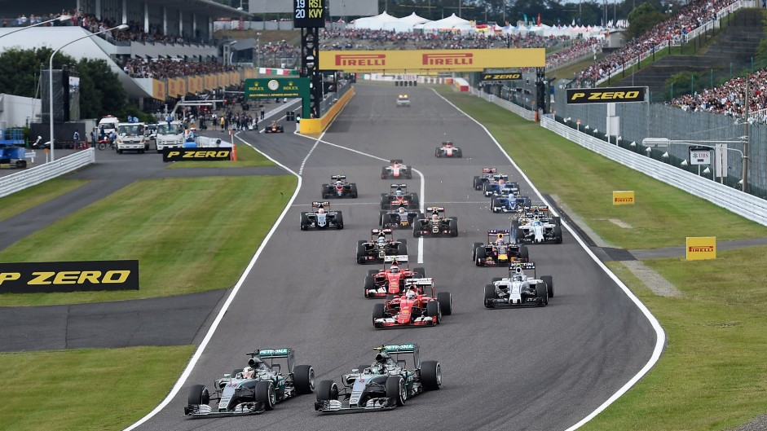
End of Show
Thank You

